Slide 1

Yoga Tracker
Dustin Cardoso
Kailash Permaul
Barath Narayn Reddy Dandu

Slide 2
Introduction
Health oriented app that provides exercises to do while sitting down
Gentler movements provide muscle stimulation without stress
Help the elderly or injured stretch and get exercise
Disability, sports injuries, old age

Slide 3
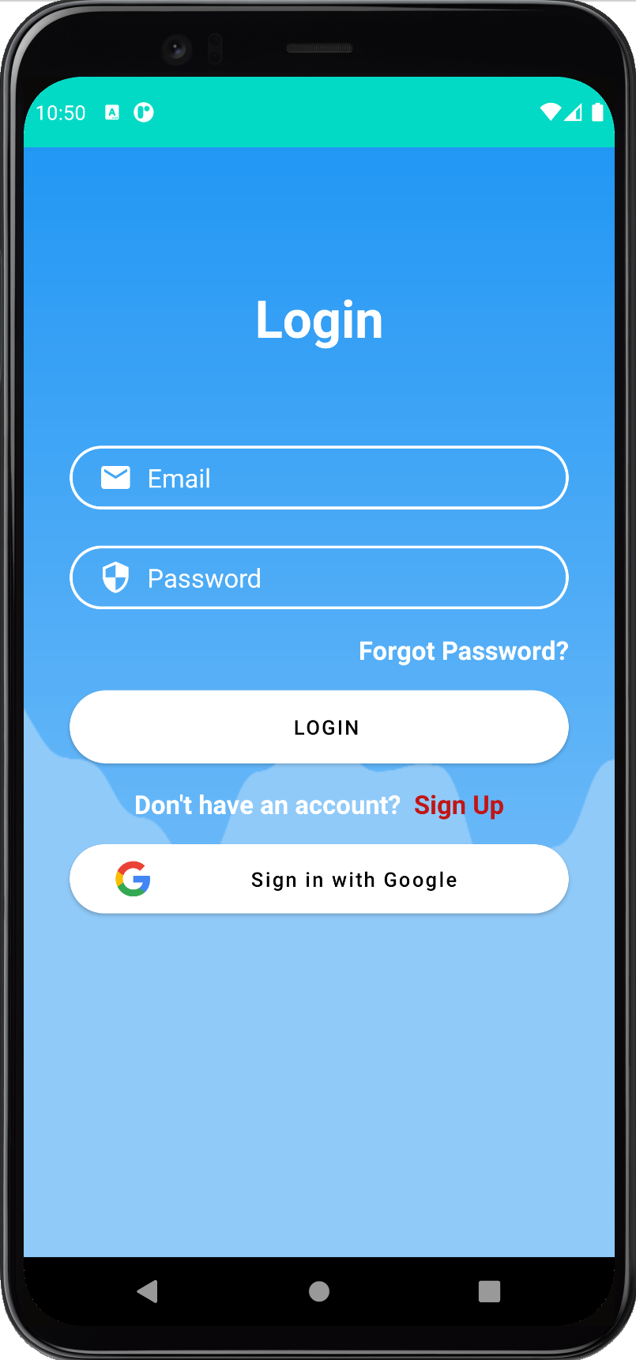
Login Activity
The login activity is the first screen that user sees when they open the application, and it works using Firebase.
The user can login using their email ID and password if they have an account, and if they do not want to make an account, they can also sign in using Google.
The login activity can also take the user to other activity pages such as register activity and the forgot password activity.
The code for the login activity also has input checking so that the user cannot type improper inputs into the input fields and login.
The input checking checks if the email is a valid email address, and the password is at least 6 characters long to sign in.
Errors and warnings on this page will be displayed using Toasts and the requestFocus() function.

Slide 4
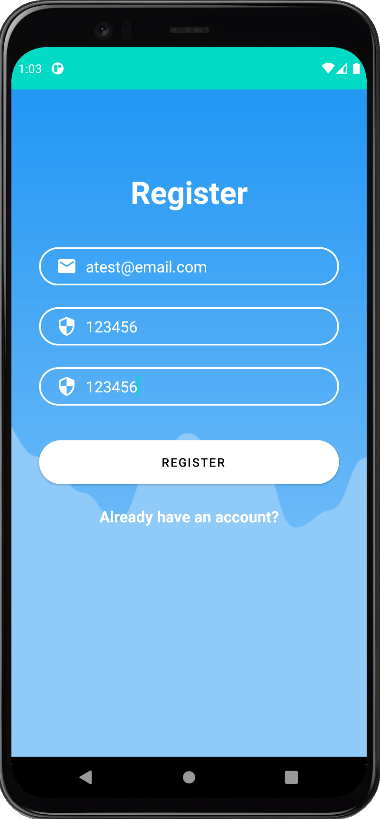
Register Activity
RegisterActivity can be accessed using the Sign Up textView.
If the user doesn’t have an account to login, they can create a new account using the register activity.
The editTexts in register activity have input checking to make sure that the email entered is a valid email type and the entered password is atleast 6 characters long and the entered passwords match for creating an account.
When the user creates an account, the new account information is stored in Firebase and in Firebase Database.
The registerActivity and loginActivity both use Firebase Authentication.
If the user already has an account, the "Already have an account" textView will take the user back to the LoginActivity.

Slide 5
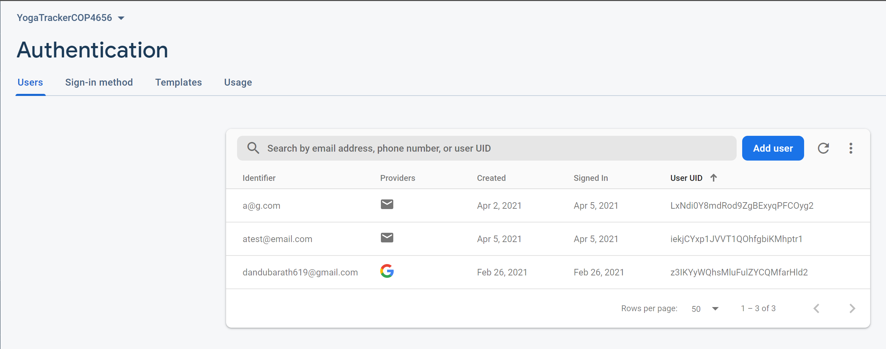
When a new user registers their account, they get a unique user UID. This UID is used to make a tree in the database, and all the information about the user's exercise, goals and their sensor accuracy is all stored in the Firebase Database under their UID.

Slide 6
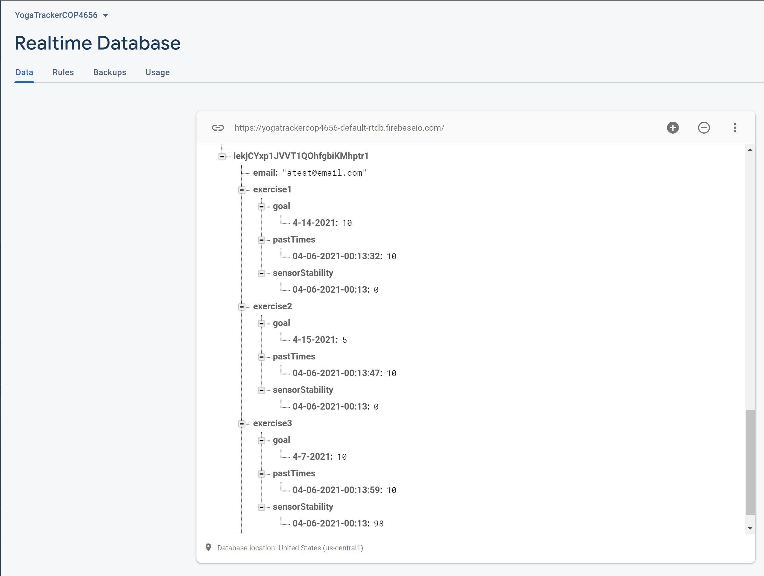

Slide 7
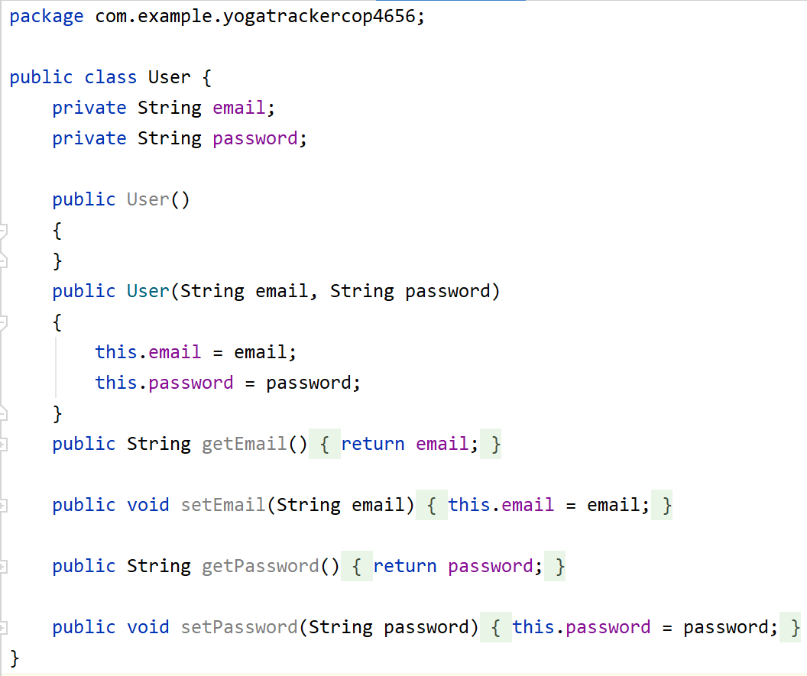
User
The User.java class is used to create the initial tree in the firebase database for the user.
This Class takes the email and the password of the user and stores them in a new tree which is named after the User's UID.

Slide 8
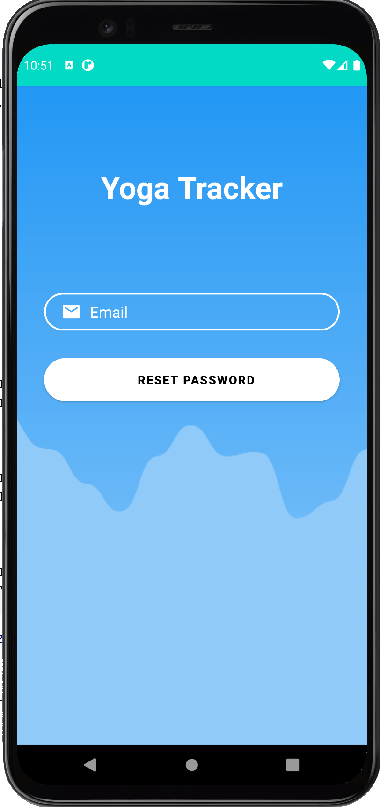
ForgotPassActivity
The ForgotPassActivity can be opened from the LoginActivity.
The user could reset their password if they forgot their password from this page.
The ForgotPassActivity also has input validation.
It will check if the entered email is valid or not, and it will also check if the email entered already has an account.
If the entered email doesn’t have an account, the application will display a Toast message saying "Please create an account before resetting password"
If the entered email is valid, the Toast will display "Check email to reset password" and the user will get a link to reset their password.

Slide 9
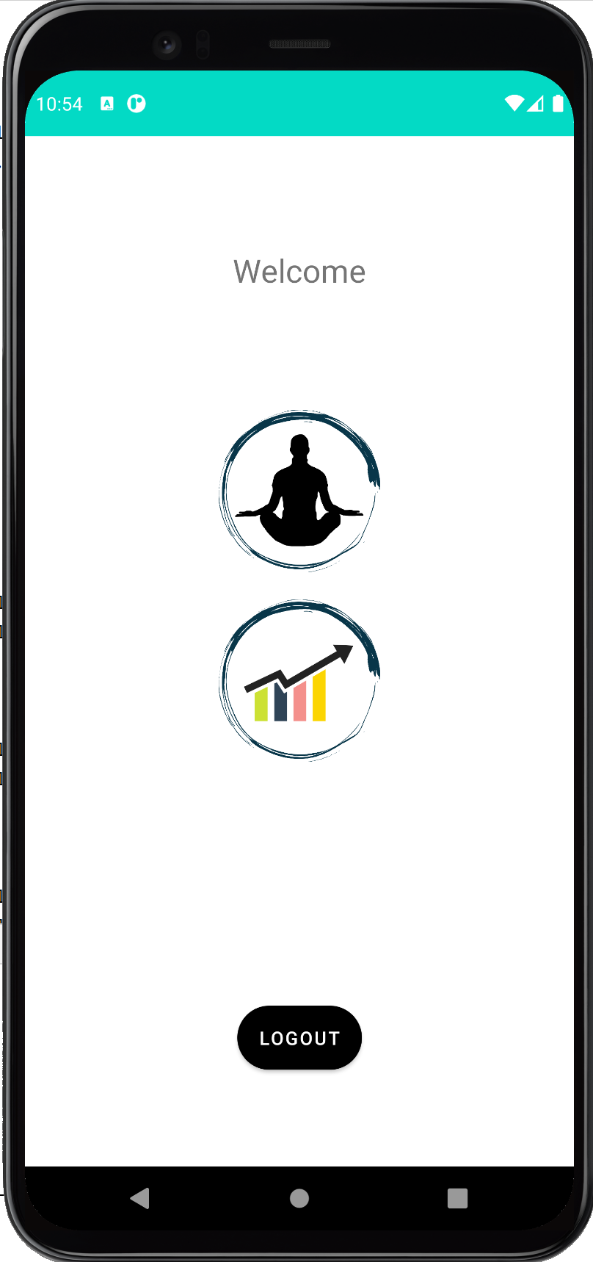
Main Activity
This is the main navigation hub as pulled up after user login
It can be accessed from Login Activity
It allows user to Logout, leading to Login Activity, or to proceed to Stat Selection or Exercise Selection
Clicking on the Yoga pose leads to exercises
Clicking on the Bar/line chart leads to Stat Selection

Slide 10
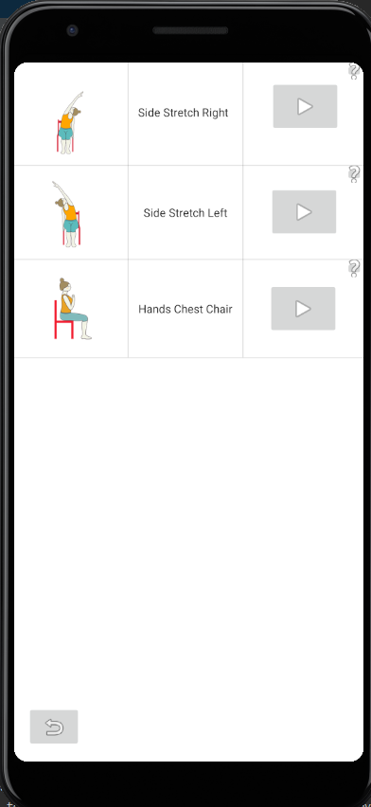
Exercise Selection
This is where users will select which pose they want to do
Acessed from Main Acitivity
Left Pannel: Image of Pose
Center Pannel: Pose name
Right Pannel: Play and Help buttons
The bottom of the display shows a back button which will allow users to go back to Main Activity
From this activity you can access activity play, help, and go back to main activity

Slide 11
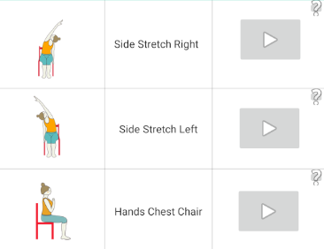
Exercise Selection
Play and help buttons use android::onClick
Each onclick has its own function
Passes intents to Activity Play and Help.

Slide 12
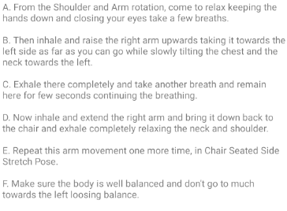
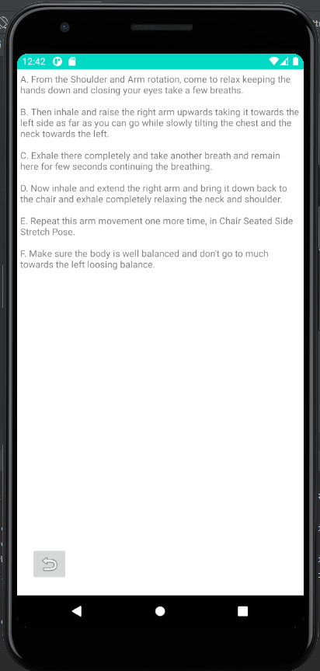
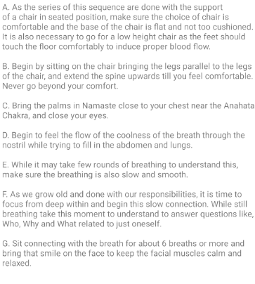
Help
Gives a discription on how to do each excersice
Accessed from Exercise Selection
Uses intents to diplay the correct iformation
Is a scroll view

Slide 13
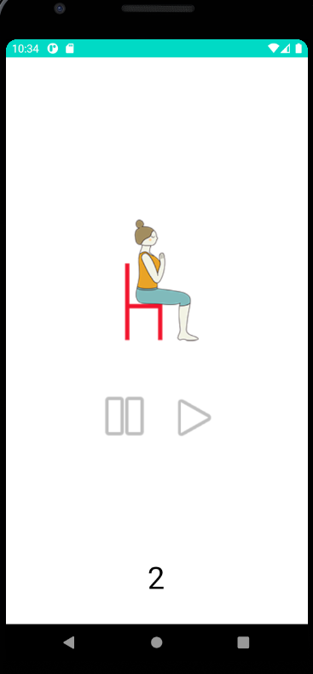
Activity Play
Main aspect of app
Measures sensor readings whenever they change
Combination of accelerometer and magnetometer
Once the timer ends, data is pushed to firebase
Timer has a default of 10 seconds unless a "goal" is set
Play button begins exercise, stop button ends activity and sends you back to the exercise selection screen

Slide 14
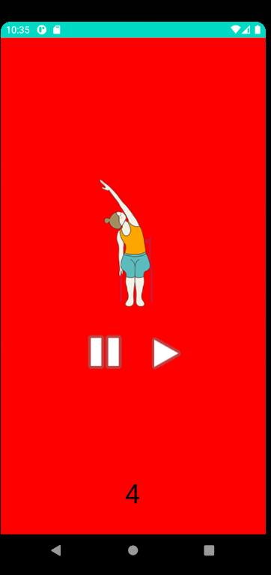
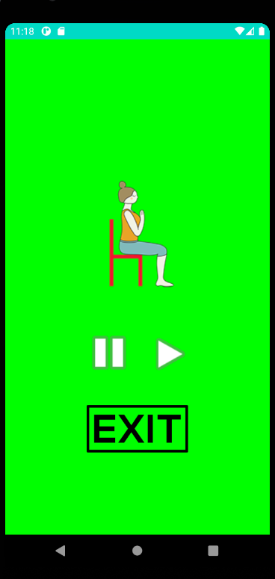
Activity Play
Once play is hit, the app begins listening to sensors
The combination of accelerometer + magnetometer gives the orientation(pitch, roll, azimuth) of the phone
Activity checks to see if orientation is in range depending on exercise
If not in range, the phone tells the user by turning red
Returns to white upon correction
Done for a specified time through a countdown timer
Adds to a counter if sensor is in range to find overall stability
Stability/time is stored firebase for statistics

Slide 15
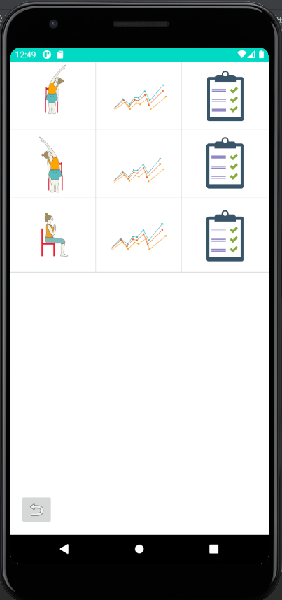
Stat Selection
This is where users set goals and view stats
Accessed from Main Activity
Left Pannel: Image of Pose
Center Pannel: Navigate to View Stats
Right Pannel: Navigate to Set Goals
The bottom of the display shows a back button which will allow users to go back to Main Activity
From this activity you can access Set Goals, Stat View, as well as go back to Main Activity

Slide 16
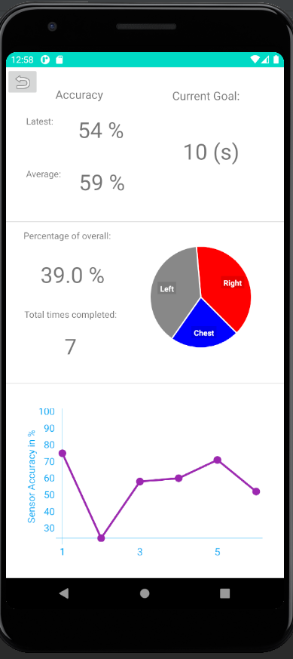
Stat View
Shows statistics for the selected exercise from past exercises
Is accessed from Stat Selection
Top Section
Accuracy of Pose: Average, Last
Current Goal
Middle Section
Percentage
Overall Times Completed
Pie Chart
Bottom Section
Line graph with sensor readings over time

Slide 17
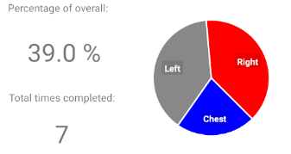
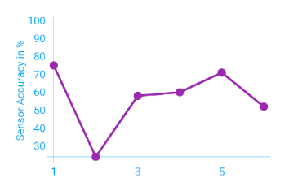
Stat View
Pulls data from database
Uses Hellocharts api to display in graphs
Charts are interactive and scalable

Slide 18
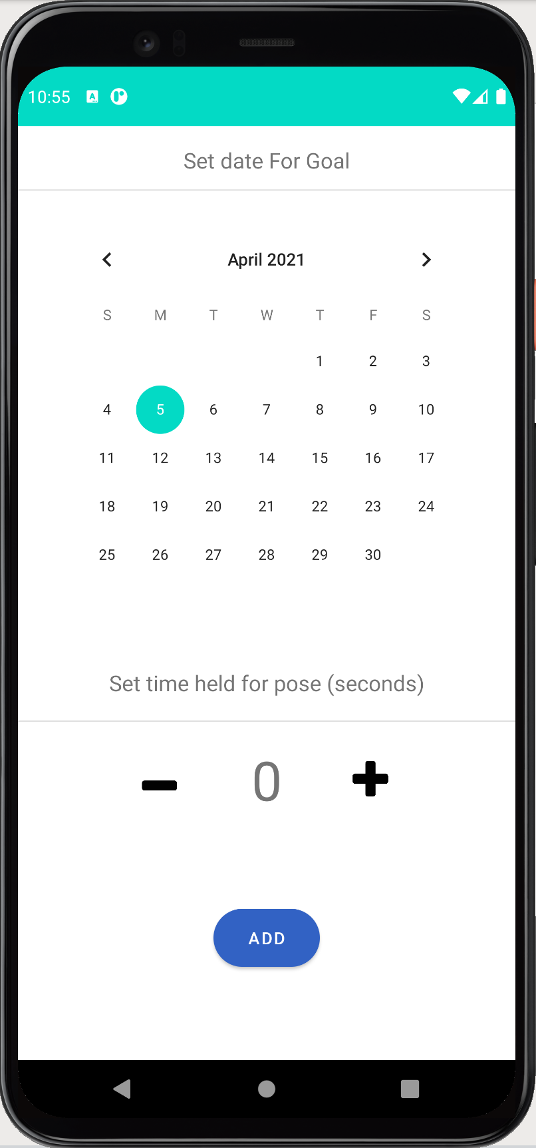
Set Goals
The Set Goals activity can be accessed from the Stat Selection activity.
The Set Goal activity is used by the user when they want to set future goals for individual exercises.
The goals that they set will be stored in the Firebase Database under the exercise that they choose, and this data would be used in Stat view activity and the Play activity.
The Set Goals activity also has input checking functionality. It makes sure that the user cannot set a goal for a previous date, and the time set cannot be negative.

